Slide 1
Workshop
The Weekli Process

Slide 2
What is The Weekli Process?
The Weekli Process is a change process that will help you as a team to identify a Current state, a Desired state and develop an Action plan that will lead to change within an area in Weekli. The subject of the workshop is an area that has a development potential based on how you all have answered the questions in the weekly pulse.

Slide 3
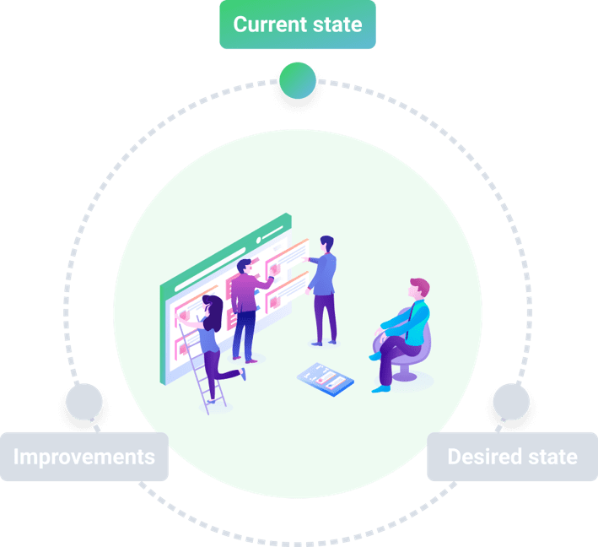
Current state
25 min
Discuss the following questions and try to be specific.
How does this low [scale] manifest itself in your team?
In which situations does the low [scale] become most obvious?
What are the consequences of this low [scale] at work?
The objective of this exercise is not to find scapegoats, but to gain a better understanding of the situation.

Slide 4
Help in identifying
Reasons at organizational level?
Reasons related to work methods?
Cultural reasons?
Reasons at an individual level?
Reasons related to the leadership?
Other reasons?

Slide 5
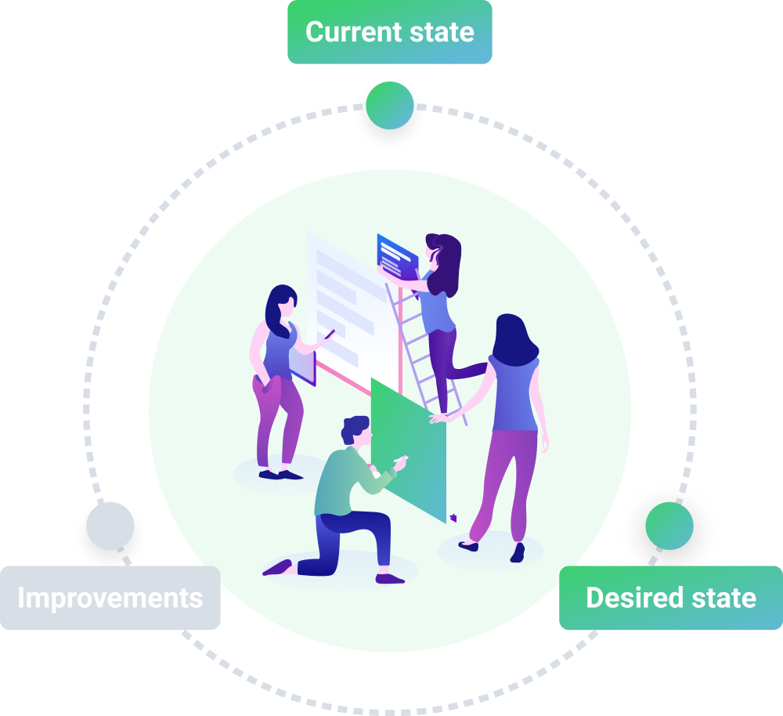
Desired state
20 min
Discuss the following questions.
What do I/we hope for, when it comes to [scale]?
If we were to achieve that desired state, what would it mean to me/us?
Try to be specific. Give examples from everyday work; meetings, discussions, decision processes etc. You should not discuss solutions yet.

Slide 6
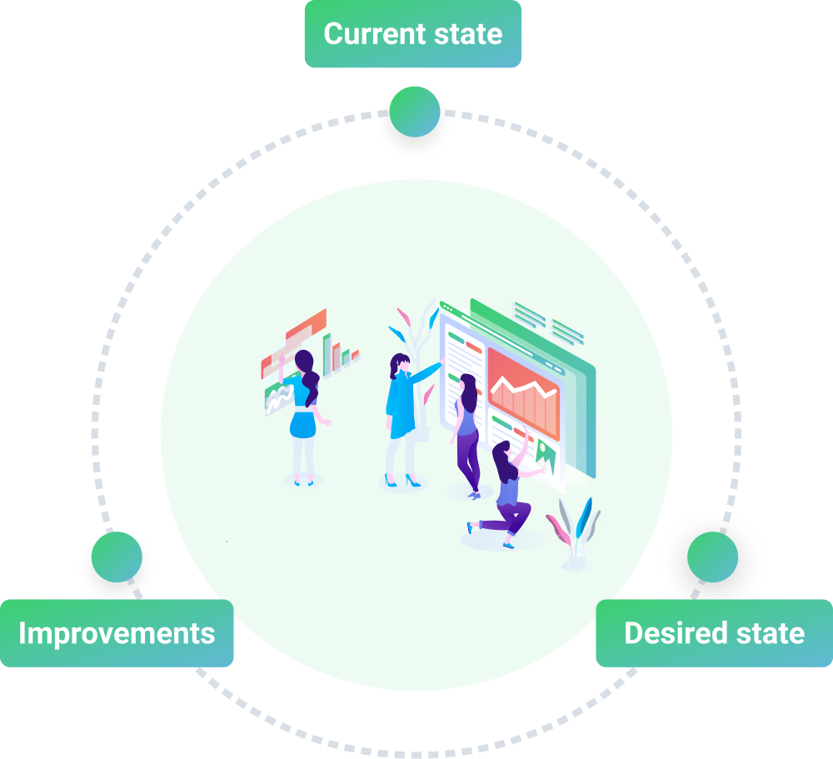
Improvements
40 min
Now you have a current state and a desired state. The next task is to come up with ideas for how to approach the desired state.
Divide yourselves into groups of two. That way it’s easier for everyone to be able to express your ideas.
Go to next slide

Slide 7
Step 1
1
10 min
Brainstorm on what needs to be done to move from current to desired state. Think freely and express all your ideas!

Slide 8
Step 2
2
10 min
Write down your ideas briefly on post-its, one idea per note. Remember here is no such thing as a stupid idea!

Slide 9
Step 3
3
10 min
One person from each group puts up the notes on a whiteboard and explains what ideas you have come up with.

Slide 10
Step 4
4
10 min
Now you have lots of suggestions on improvements in front of you. Try to group suggestions that are similar to each other and agree on a name for each group; "Information", "Cooperation", "Responsibility", etc.

Slide 11
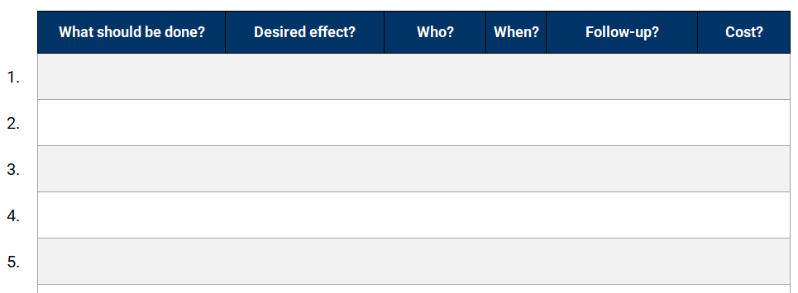
Action Plan
Now it’s time to set an action plan. What needs to be done? What desired effect will this have? Who should do it? When should it be done? Should it be followed up and will there be any costs?

Slide 12
Check out
What are your take away key points from this workshop?

